Slide 1
Cane Toads as an Introduced Species

Slide 2

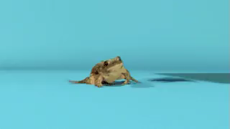

Slide 3
Cane toads are an interesting example of a biological control gone wrong.
A biological control is the control of pests by deliberately introducing one of their natural predators, or diseases.

Slide 4
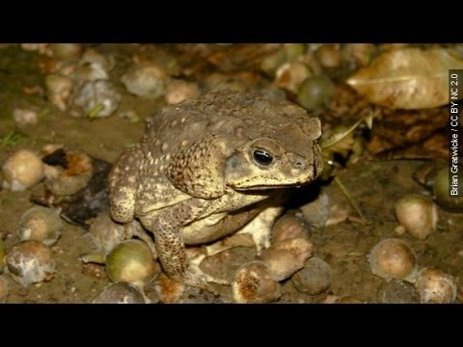

Slide 5
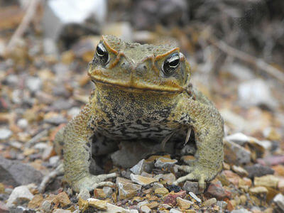
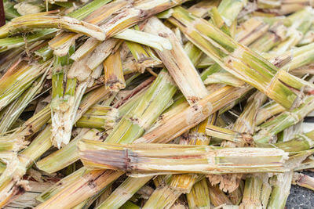
In 1935, cane toads were brought to Australia.
They were supposed to control the cane beetle, which was damaging local sugarcane crops.

Slide 6

The cane toad has no natural predators in Australia.
Some crows can eat cane toads by flipping them over and attacking the belly. However, this learned behaviour is not shown by every bird and it's still not enough to reduce cane toad populations.
Cane toads also breed at a faster and higher rate than any native frog species.
Since cane toads develop from egg to adult much faster than any other frog species in Australia, they outcompete other frog species.

Slide 7
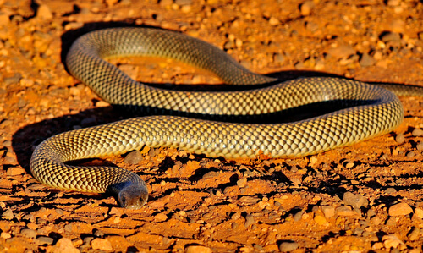
The cane toad is poisonous at every stage of its life cycle.
This has devastating effects on animals that eat the toads.
Even other poisonous animals, such as the brown snake, aren't immune to the cane toad's poison!

